Slide 1

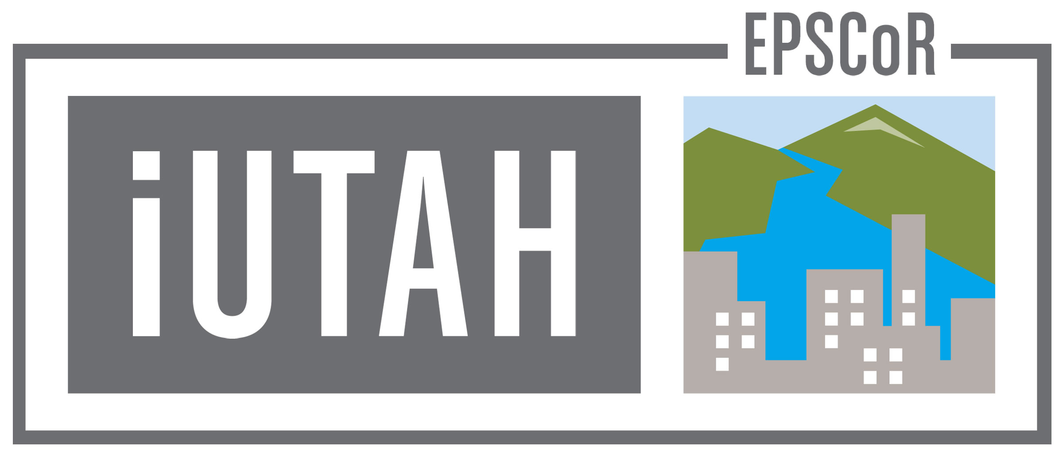

ODM Tools Python: Open Source Software for Managing Continuous Sensor Data
Jeffery S. Horsburgh
Stephanie Reeder
Amber Spackman Jones

Slide 2
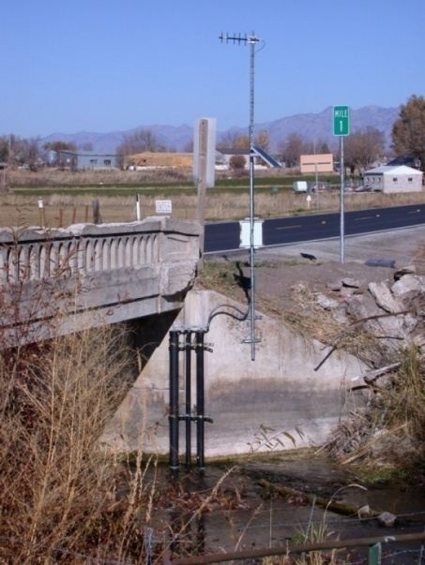
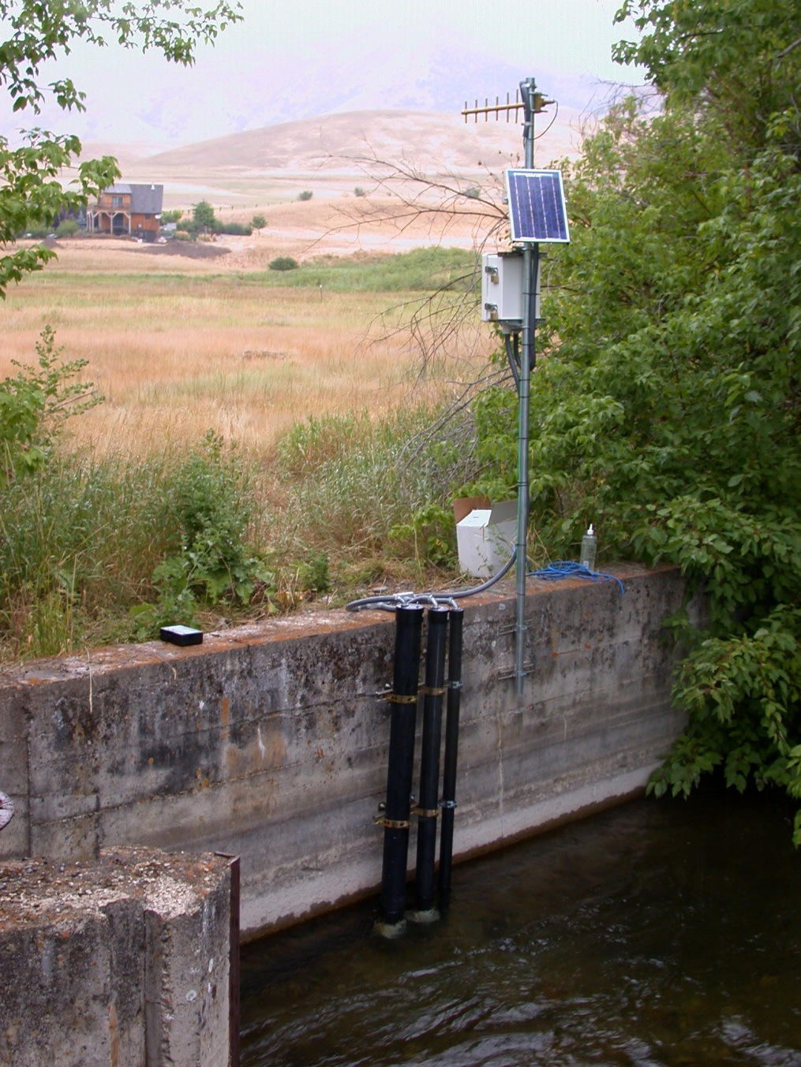
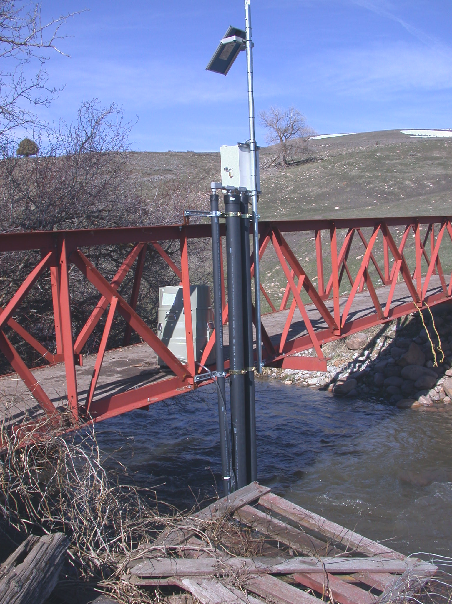
Motivation

Slide 3
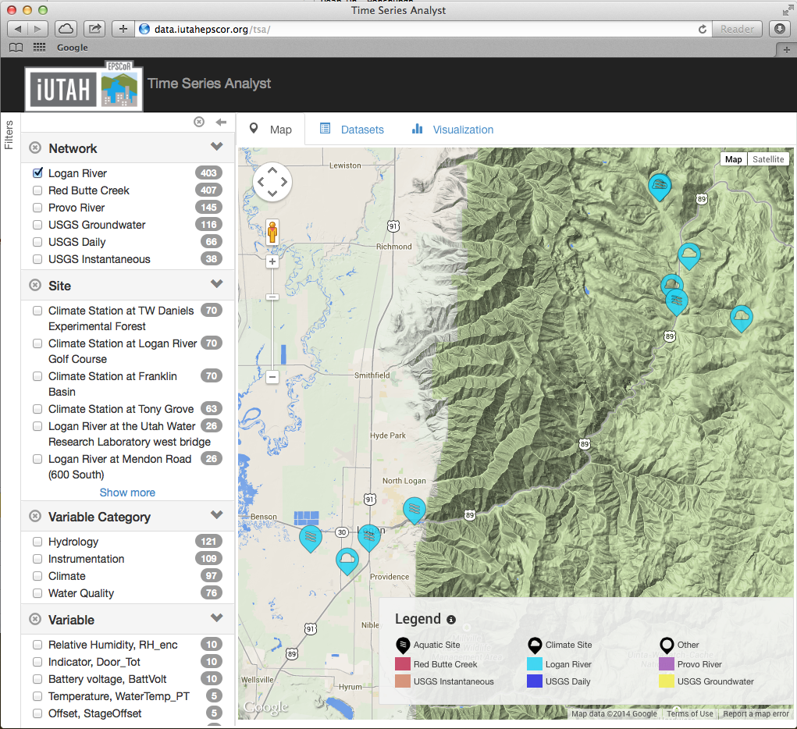
Gradients Along Mountain To Urban Transitions (GAMUT) Network
Ecohydrologic observatory deployed in 3 watersheds: Logan River, Red Butte Creek, Provo River
Watersheds with similar water source (high elevation snow) but different land use transitions
Measures aspects of water inputs and outputs and water quality over mountain-to-urban gradient
Mix of aquatic and terrestrial in situ and re-locatable sensors
Notes:
Currently ~25 climate and aquatic sites implemented with more on the way.

Slide 4
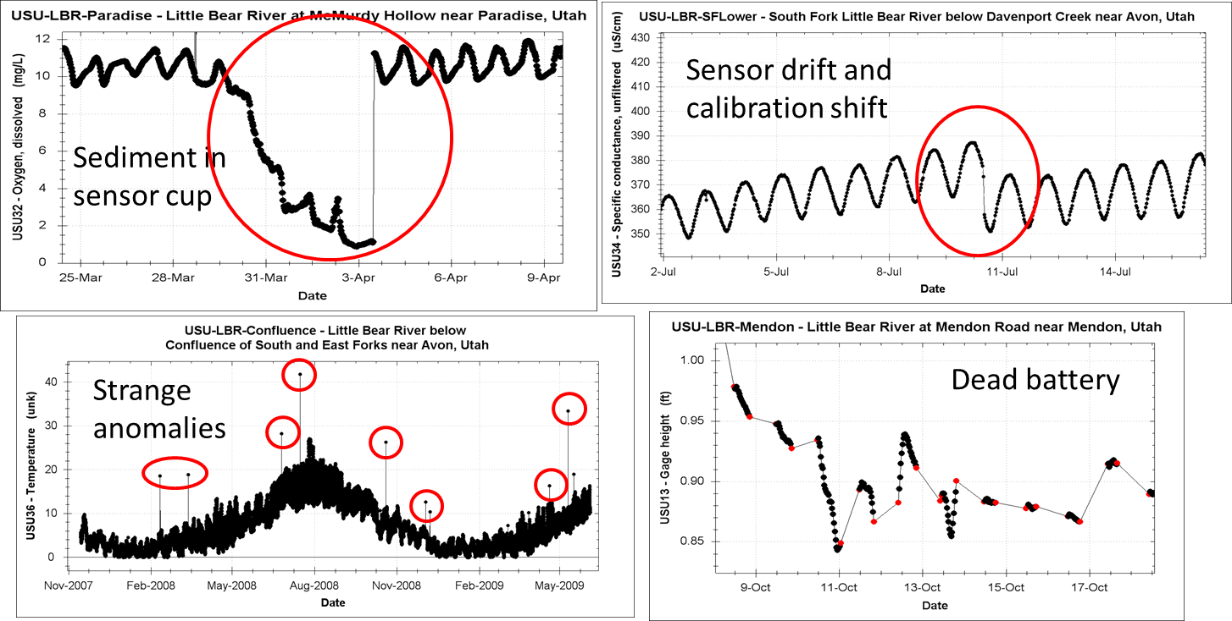
Motivation

Slide 5
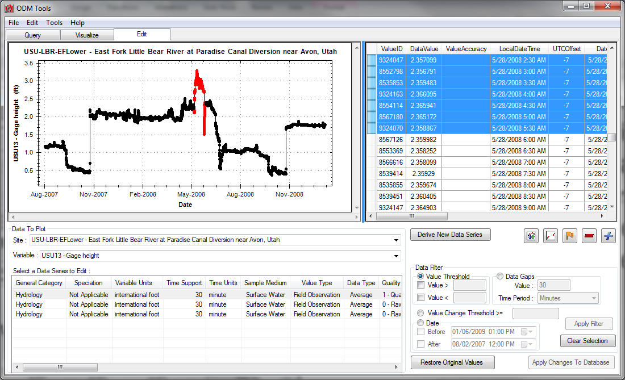

Some History
ODM Tools originally developed as part of the CUAHSI Hydrologic Information System
Developed in Microsoft Visual Studio .Net
Limited to Windows Machines
Only worked with Microsoft SQL Server databases
Provided editing tools, but did not preserve the history of edits

Slide 6
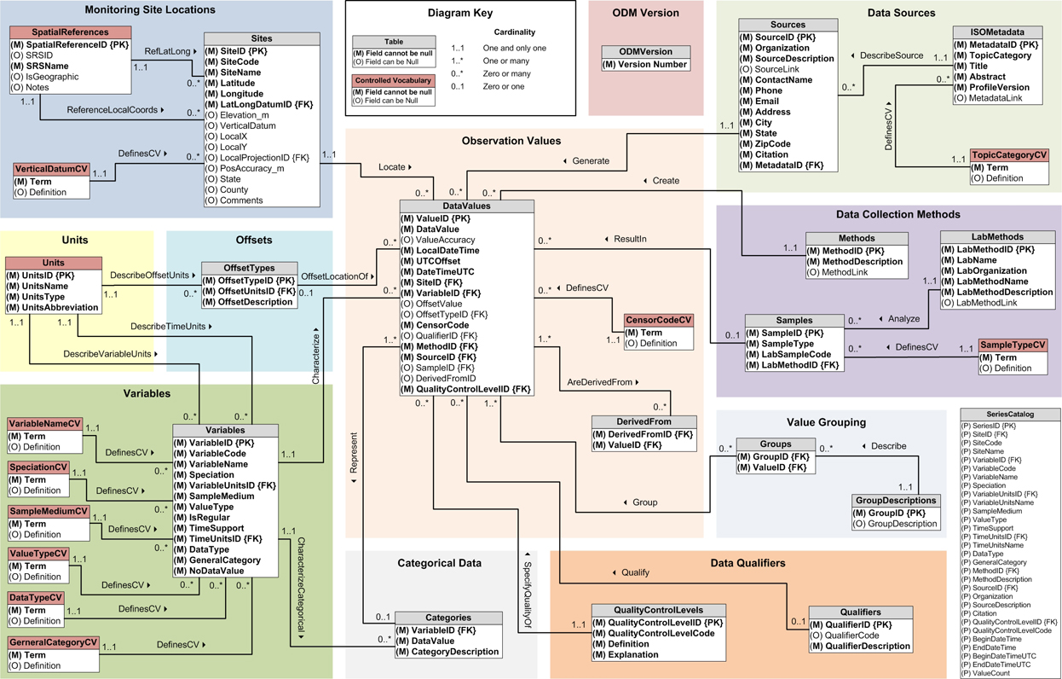
Observations Data Model

Slide 7
ODM Tools Python: Design Goals
Multi-platform support (Windows, Linux, Mac)
Multi-database support (Microsoft SQL Server, MySQL, and PostgreSQL)
Implement a scripting interface to save the provenance of data edits in QC process
Modernize the Graphical User Interface (GUI)

Slide 8
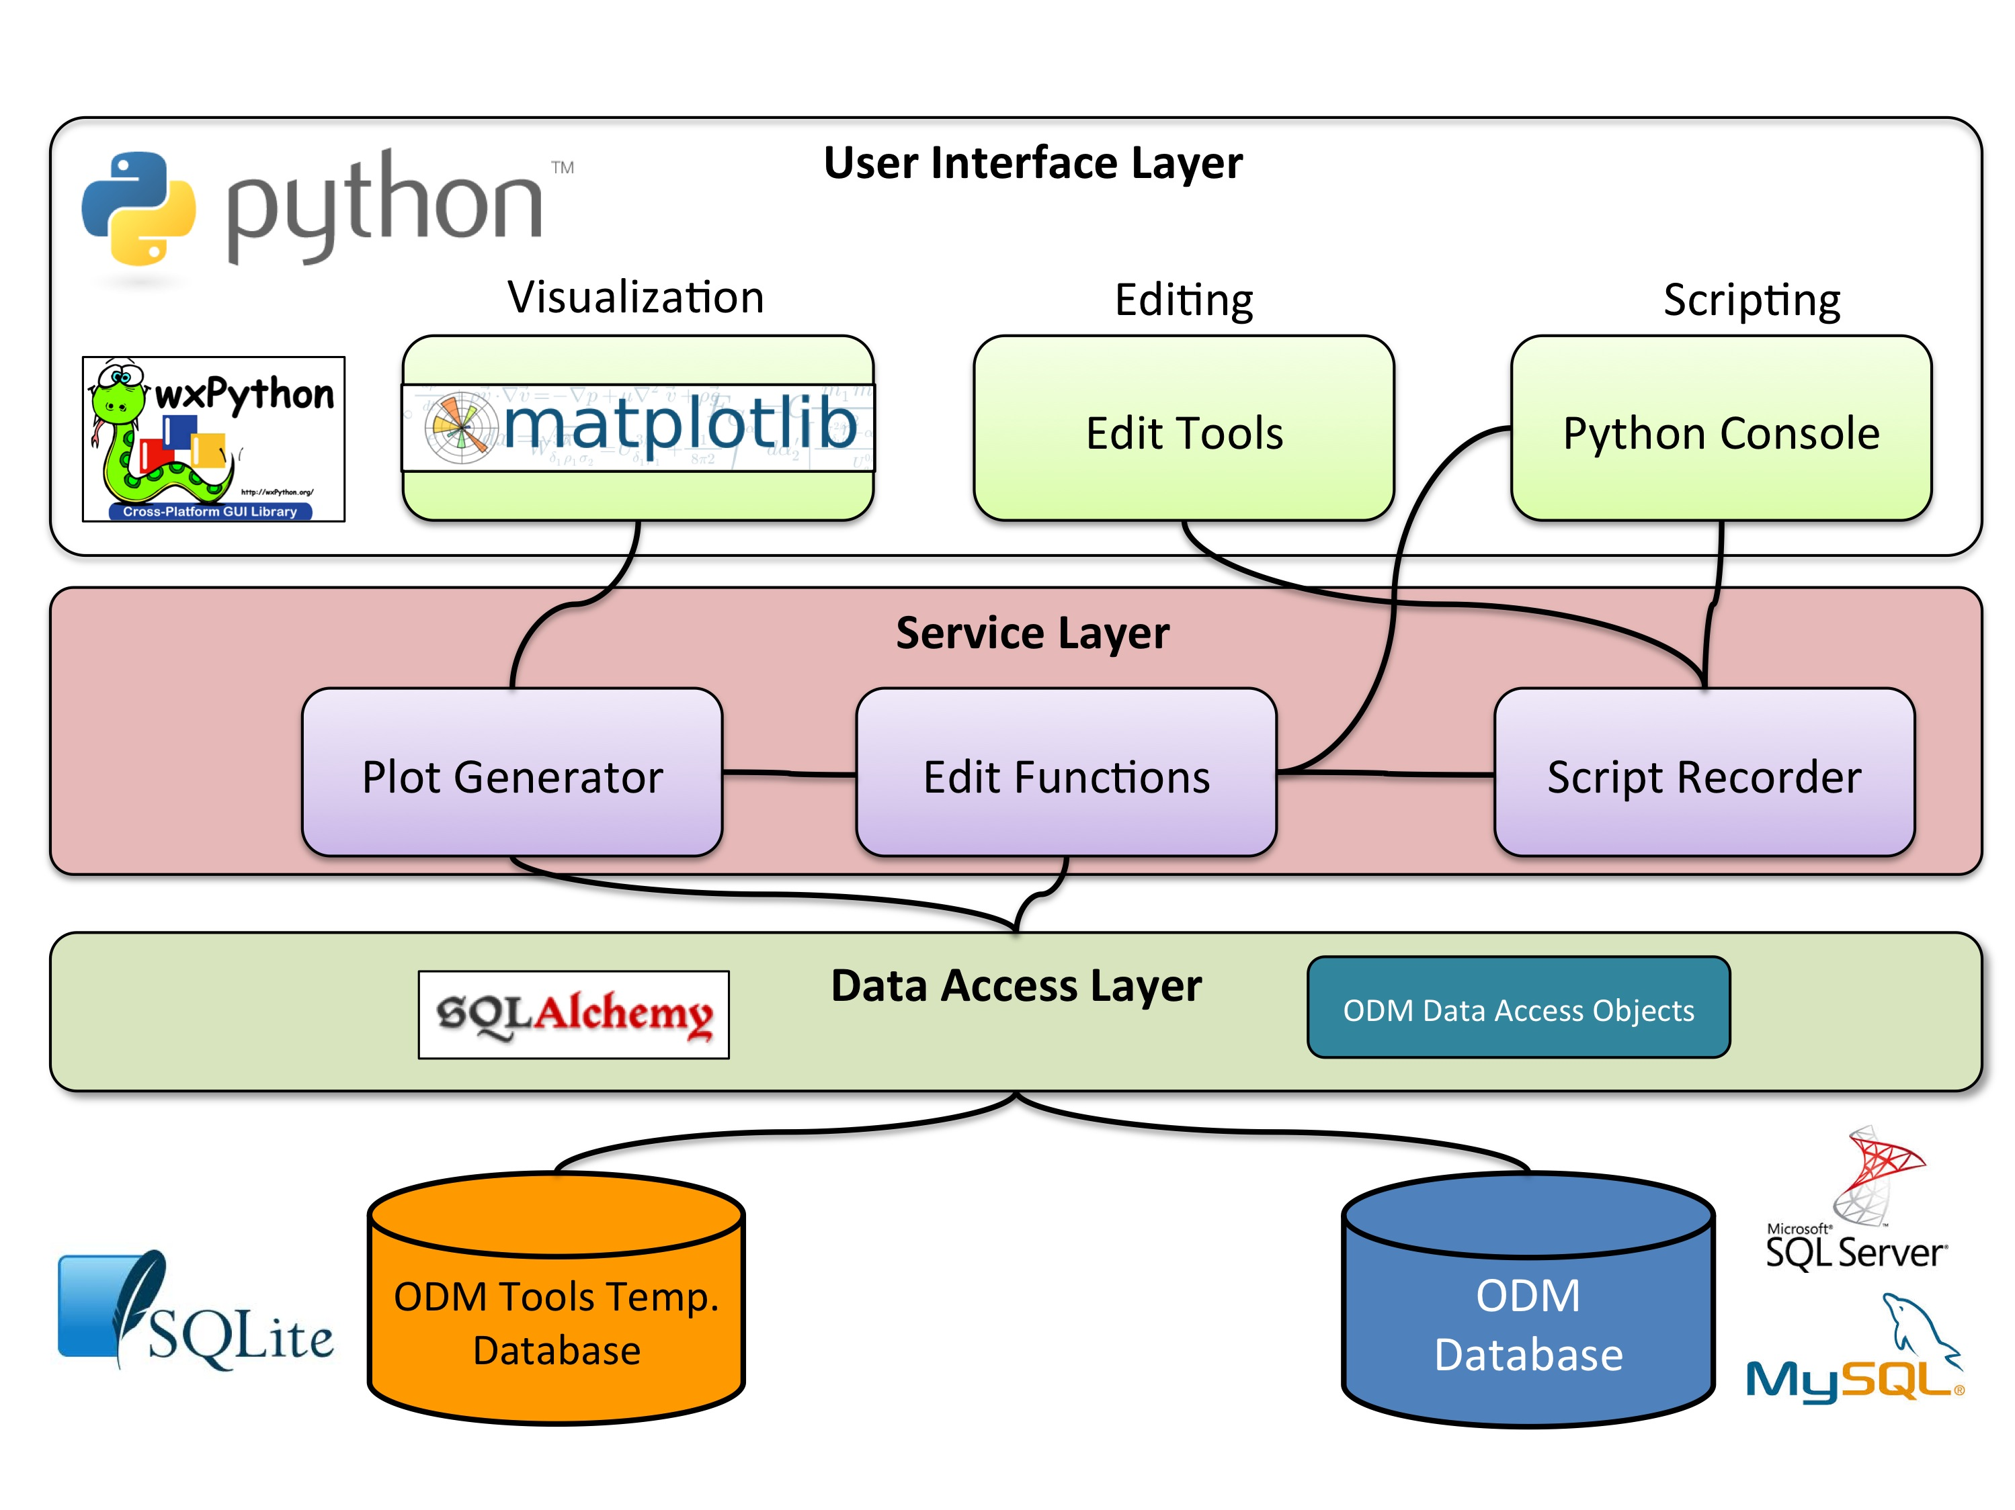
Architecture

Slide 9
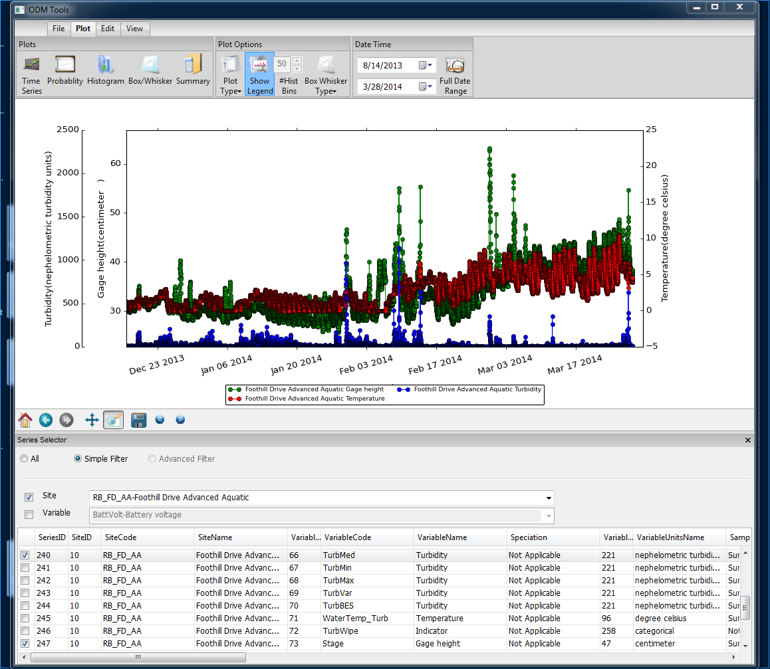
Graphical User Interface
Ribbon Toolbar
Plot Window
Time Series Selection
Notes:
ODM Tools Python:
Desktop client application for visualizing and managing data. This slide highlights some of its features.

Slide 10
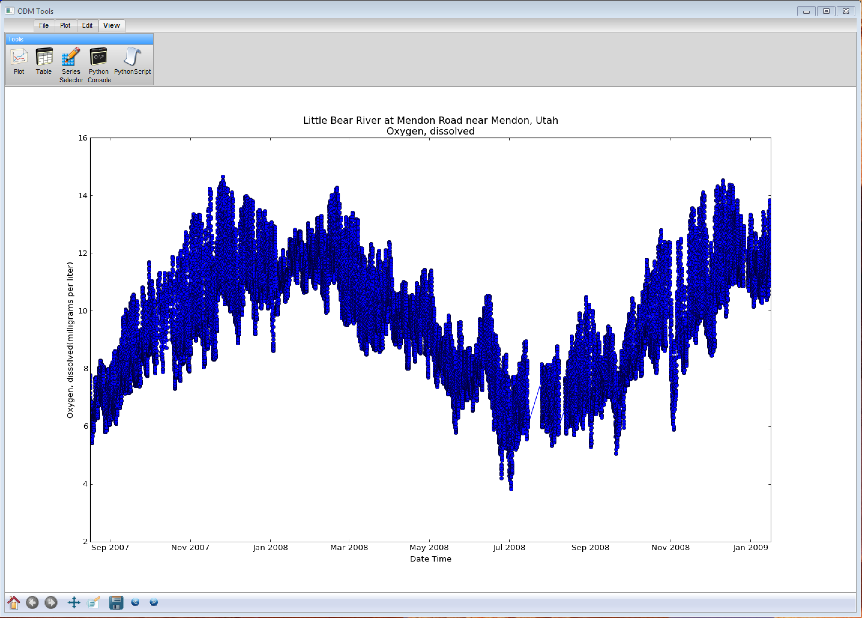
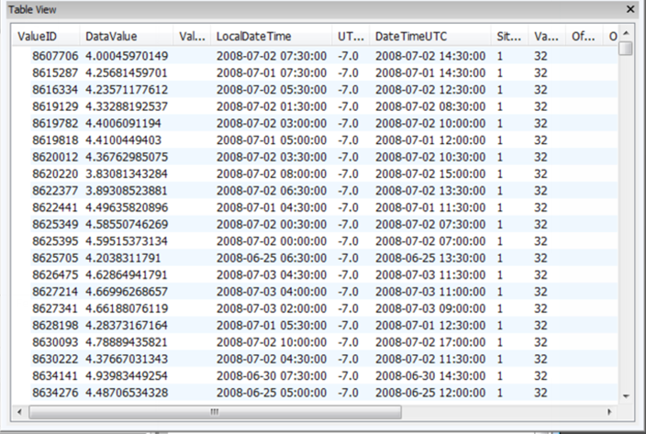
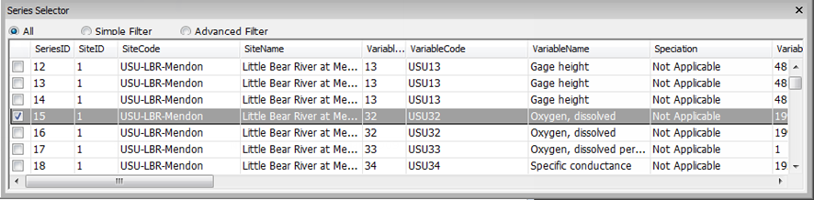
Dockable Windows

Slide 11
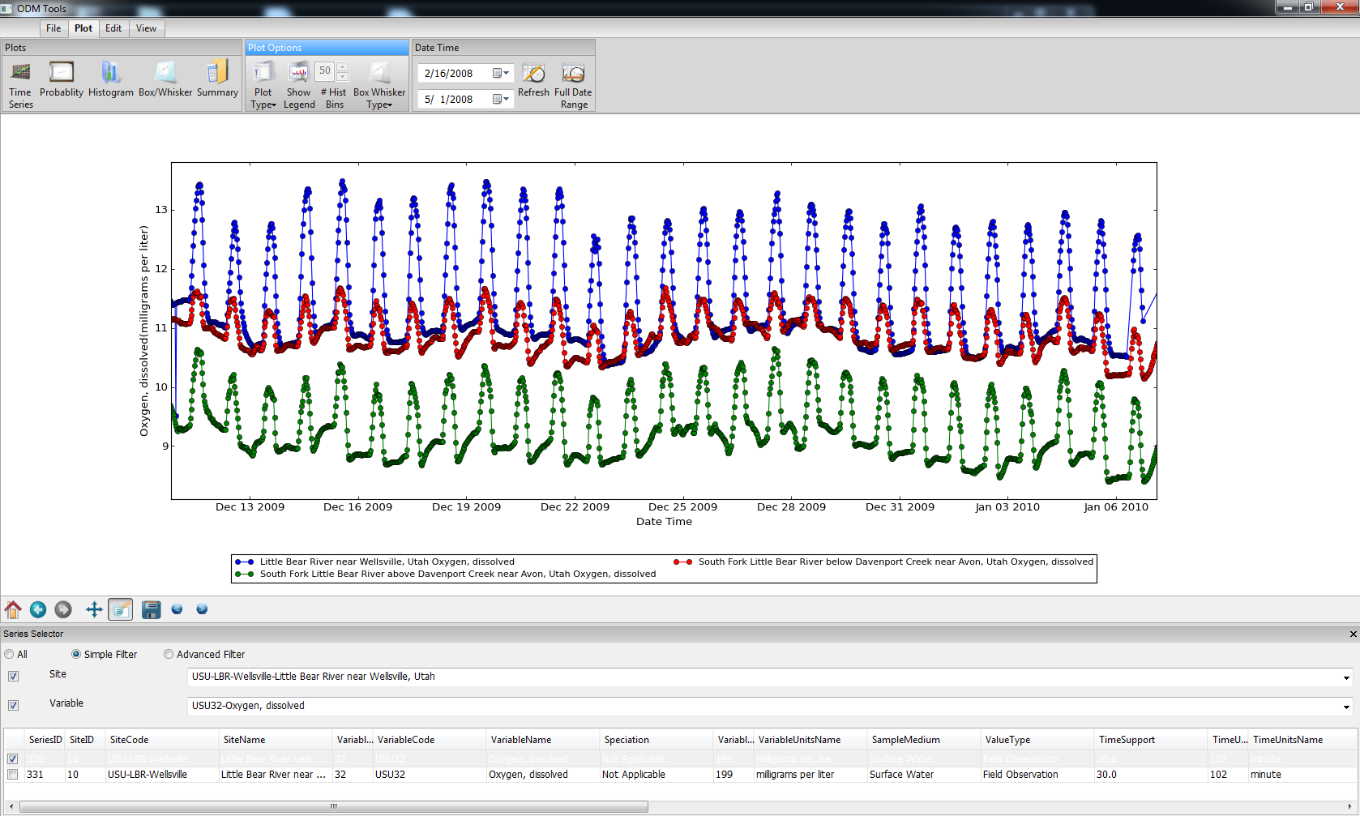
Data Visualization
Multiple Plot Types
Plot Display Options
Date Range Restrictions
Dynamic Zooming and Panning
Multiple Time Series Selection

Slide 12
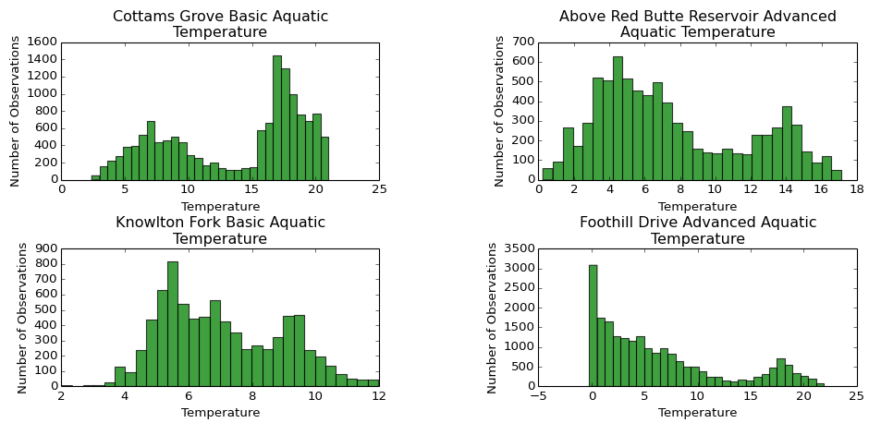
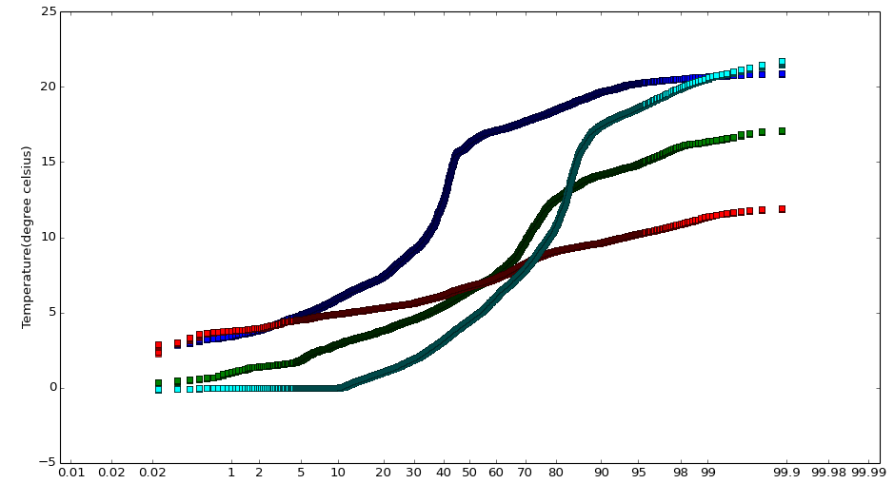
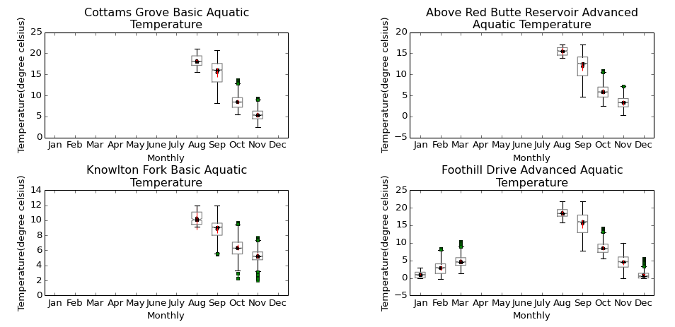
Data Visualization: Plot Types
Notes:
Ability to plot multiple data series with multiple plot types.

Slide 13
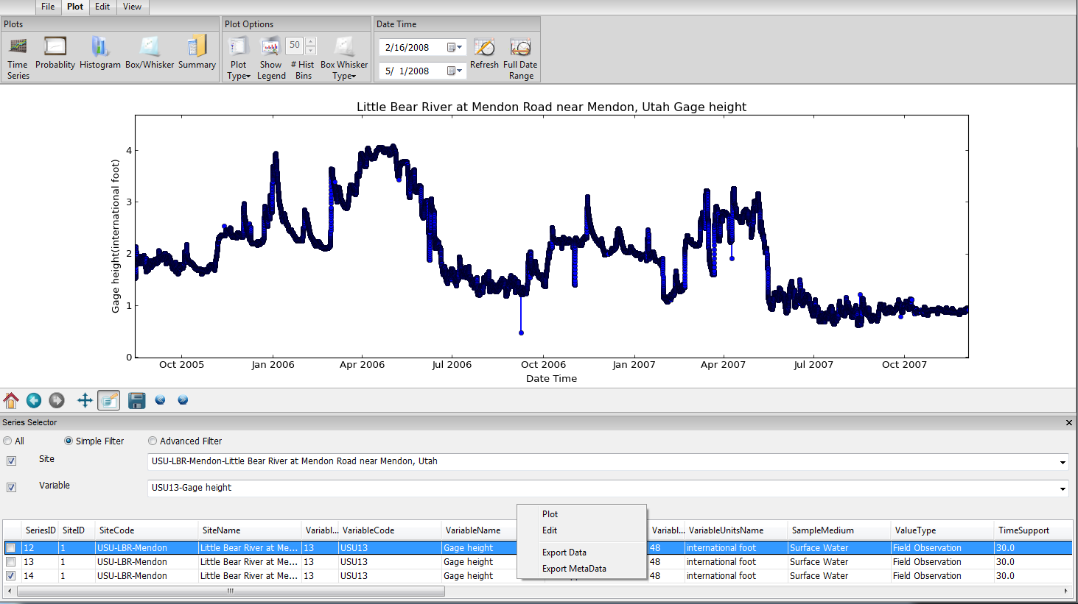
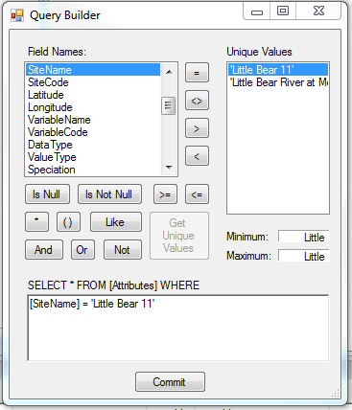
Query and Export
Build a query
Right click select and export

Slide 14
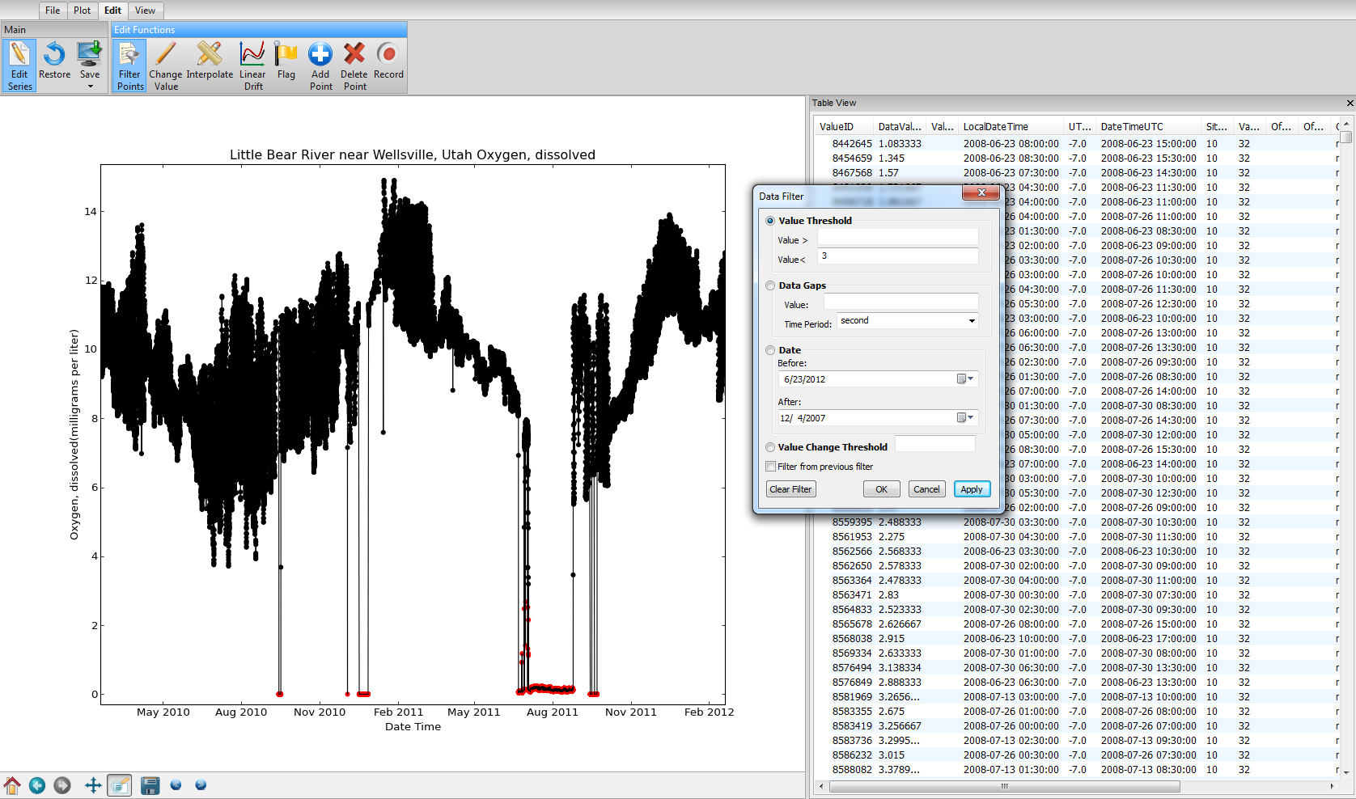
Data Editing for Quality Control
Common editing tools
Start editing and save edits
Data selection filters
Linked plot view
Tabular data view and selection

Slide 15
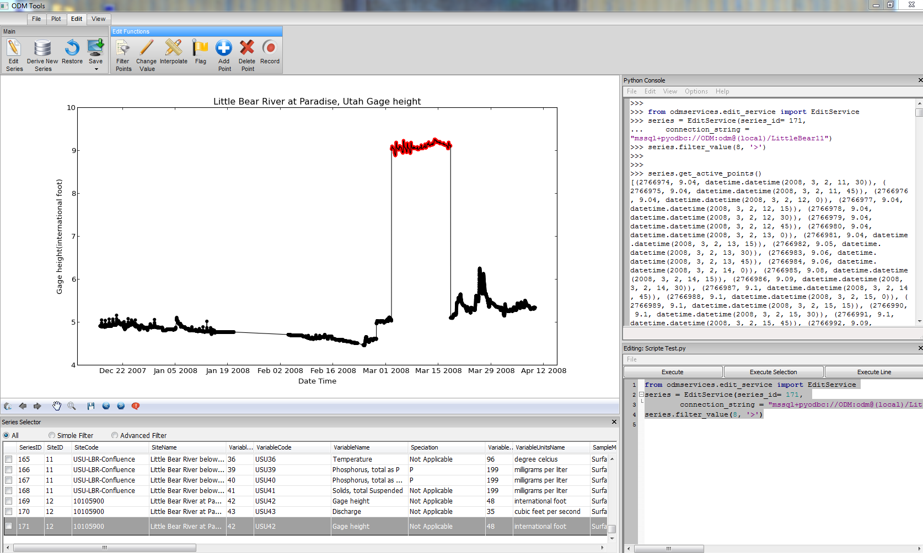
Data Editing for Quality Control
Python Code Console
Python Script Editor
Notes:
A major component of ODM Tools is the editing of data series.
Features a python code console and python script editor which permits the recording of data edits. Edits van be reviewed and are reproducible.

Slide 16
How does it work?

Slide 17
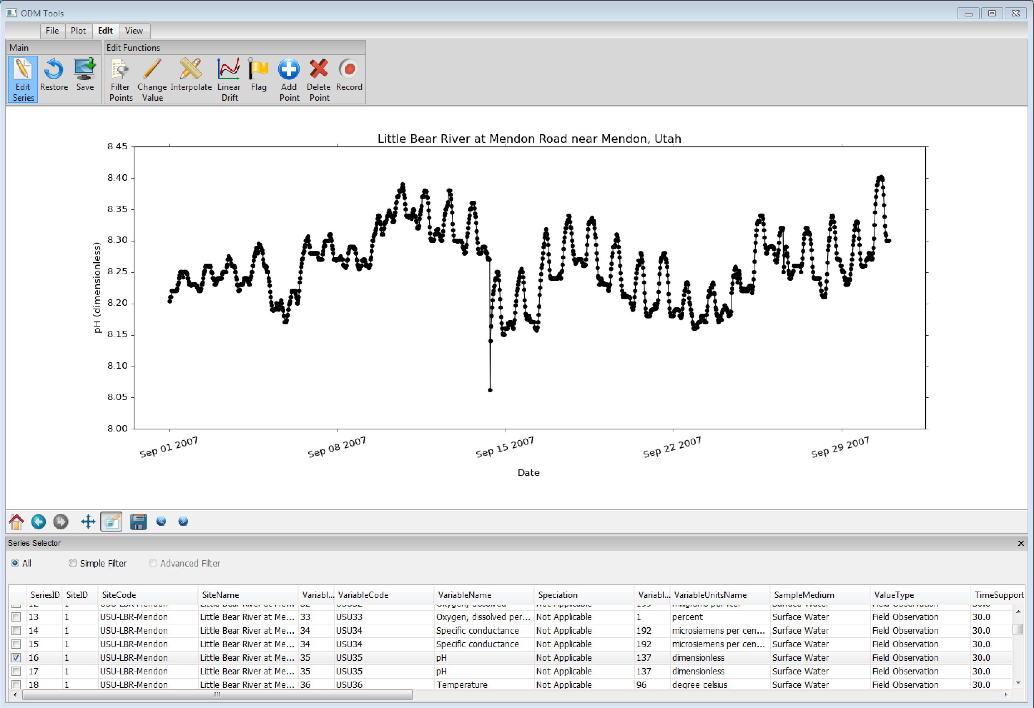
Step 1: Select a Time Series for Editing
Edit Series
Drift and calibration shift
Select Series

Slide 18
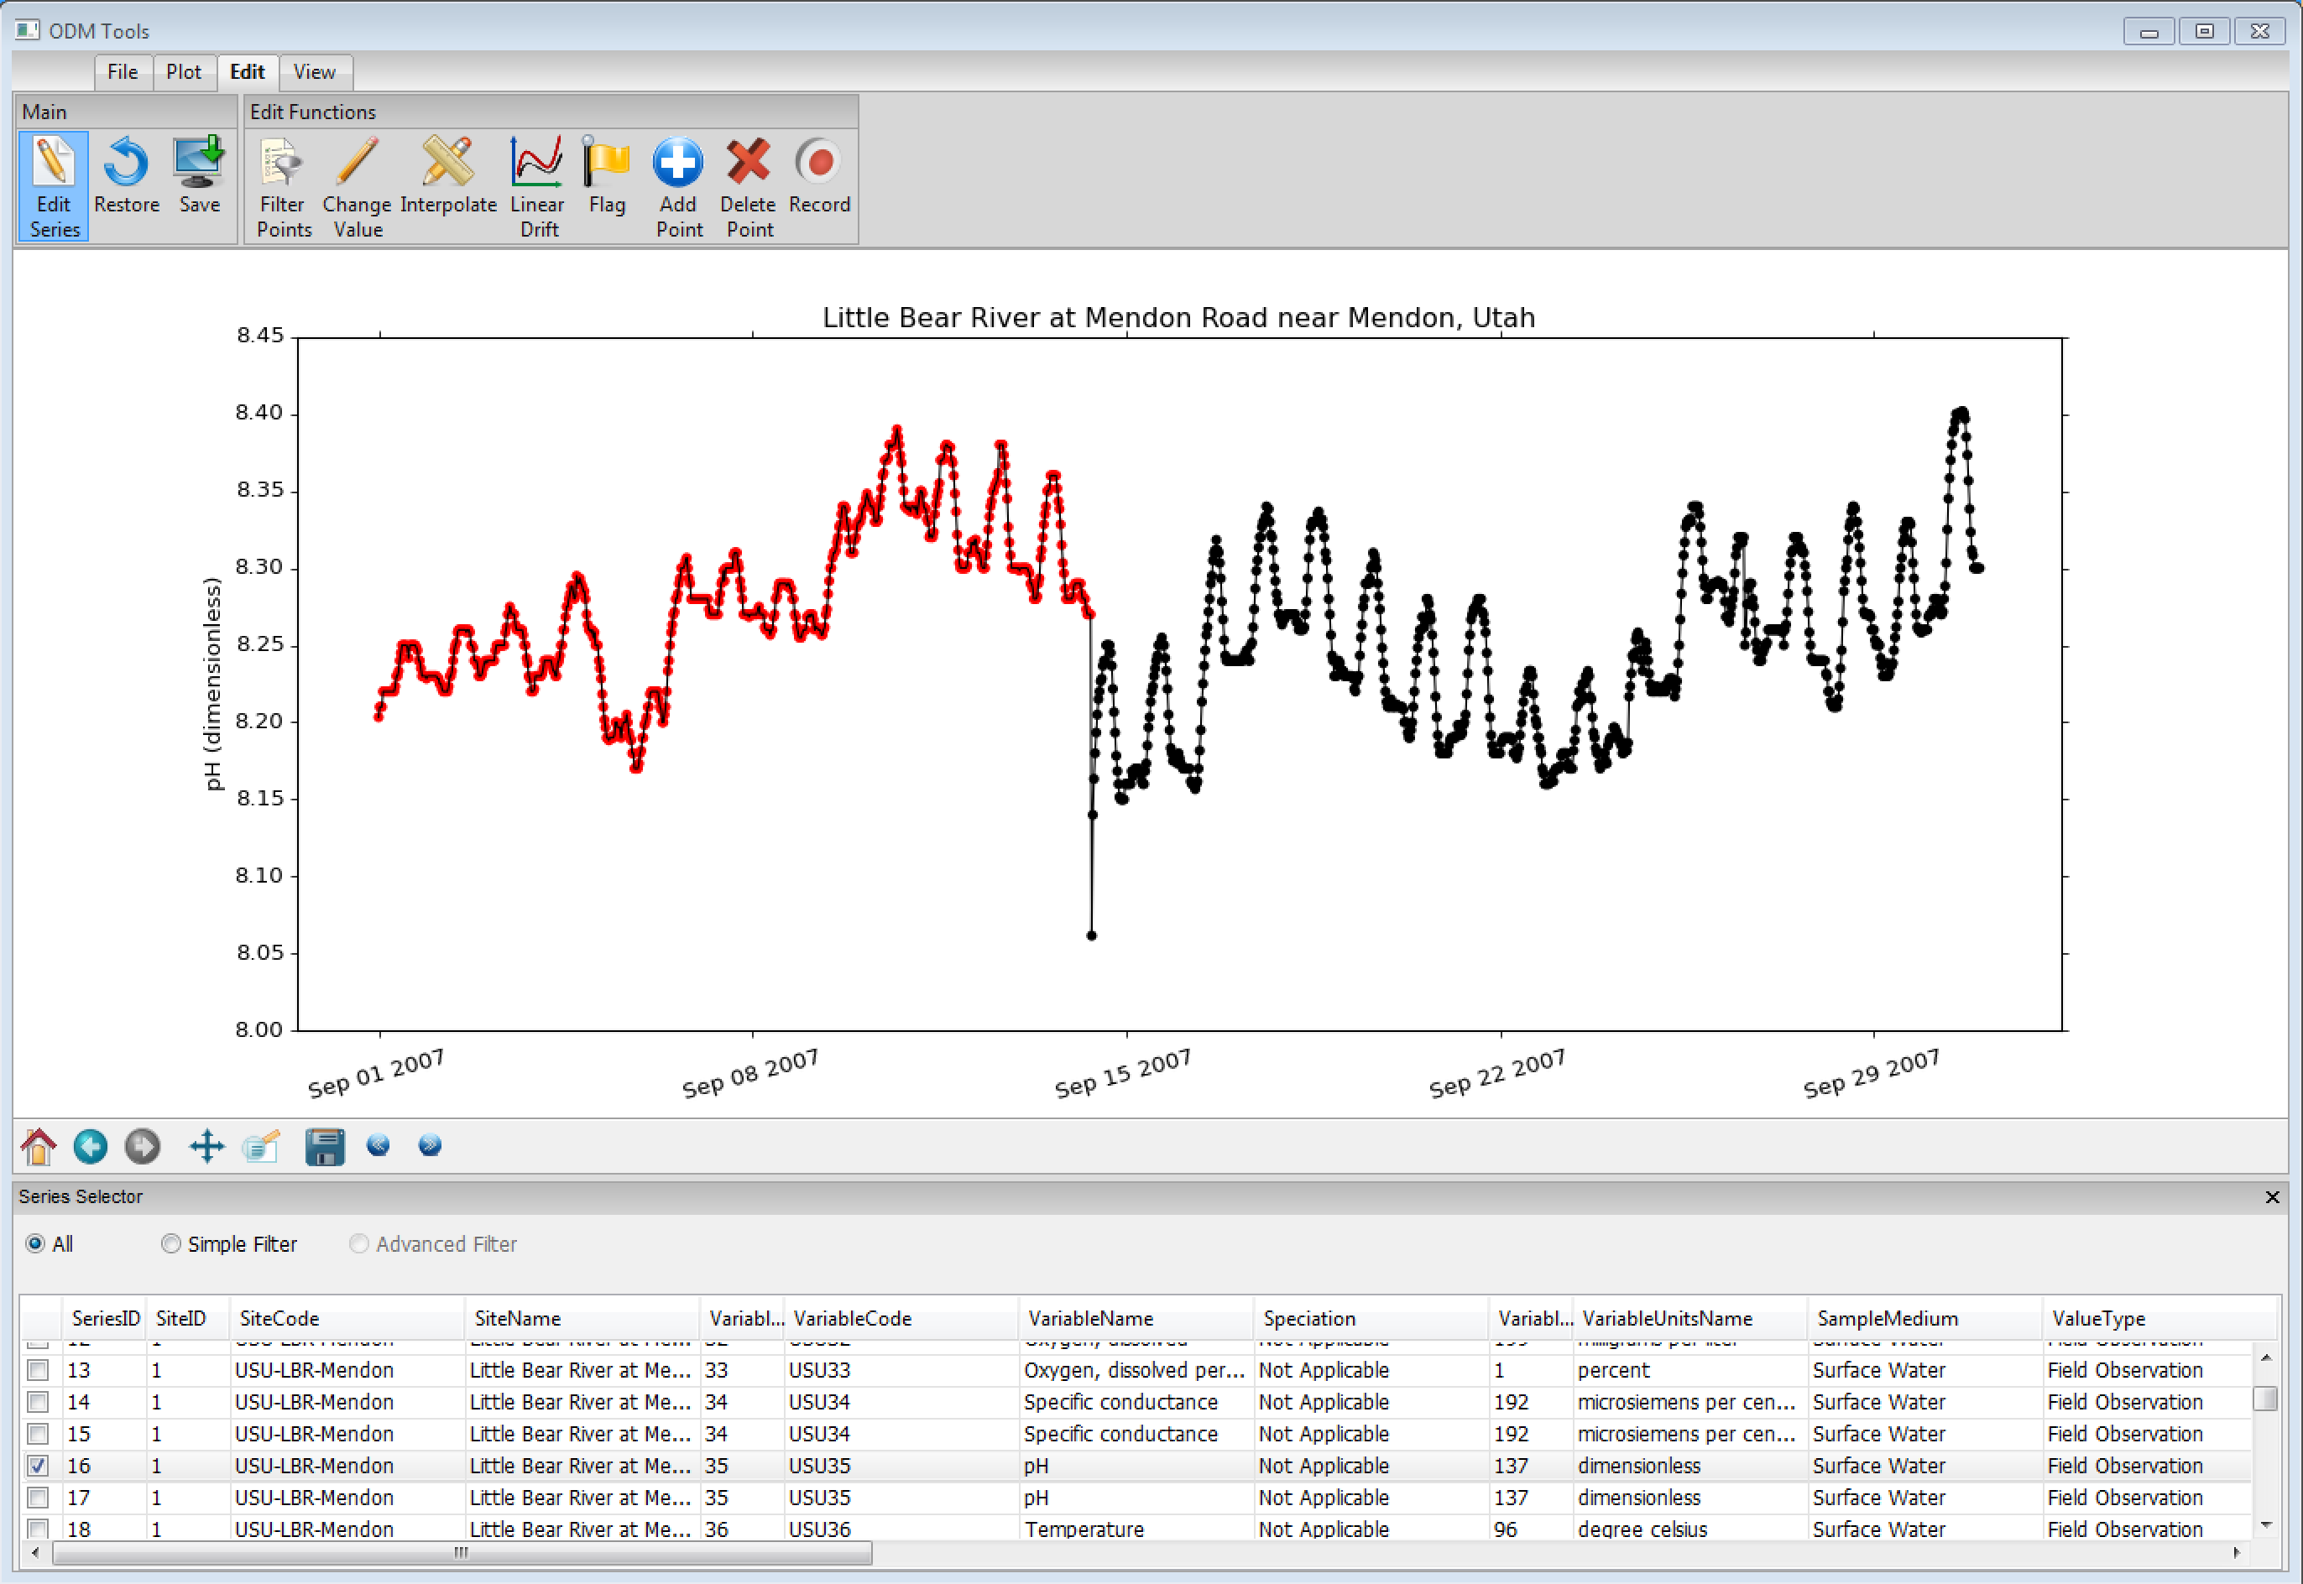
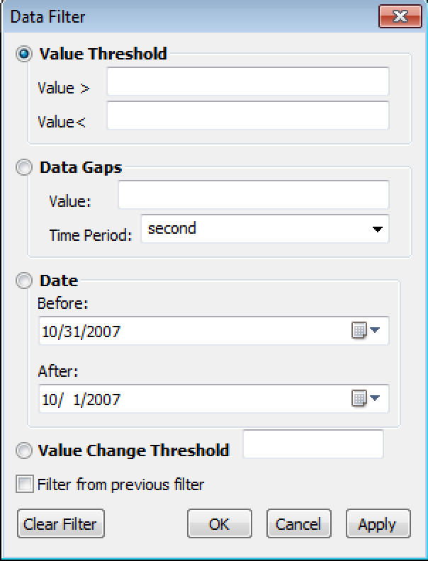
Step 2: Select Data to Edit

Slide 19
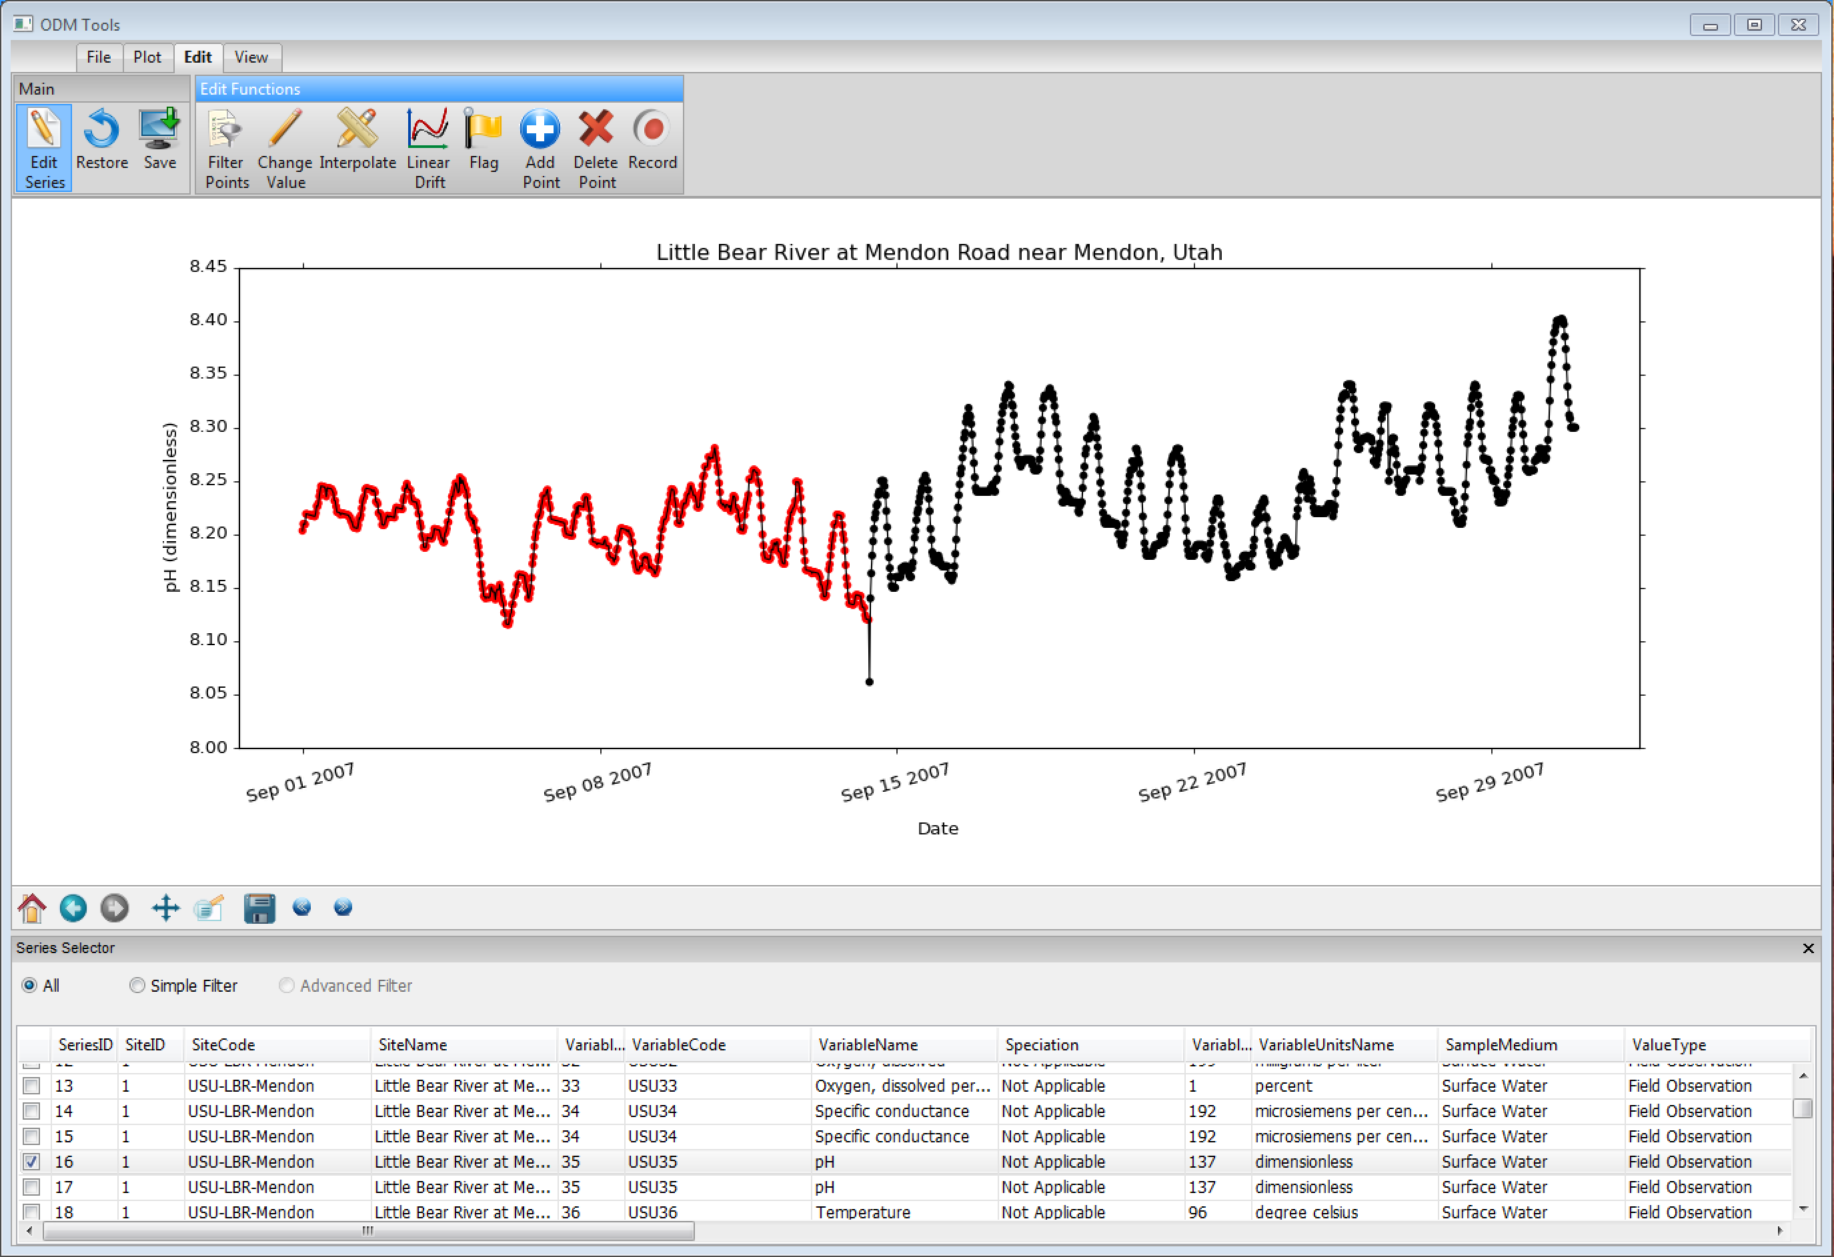
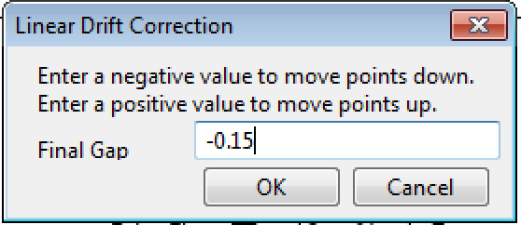
Step 3: Linear Drift Correction

Slide 20
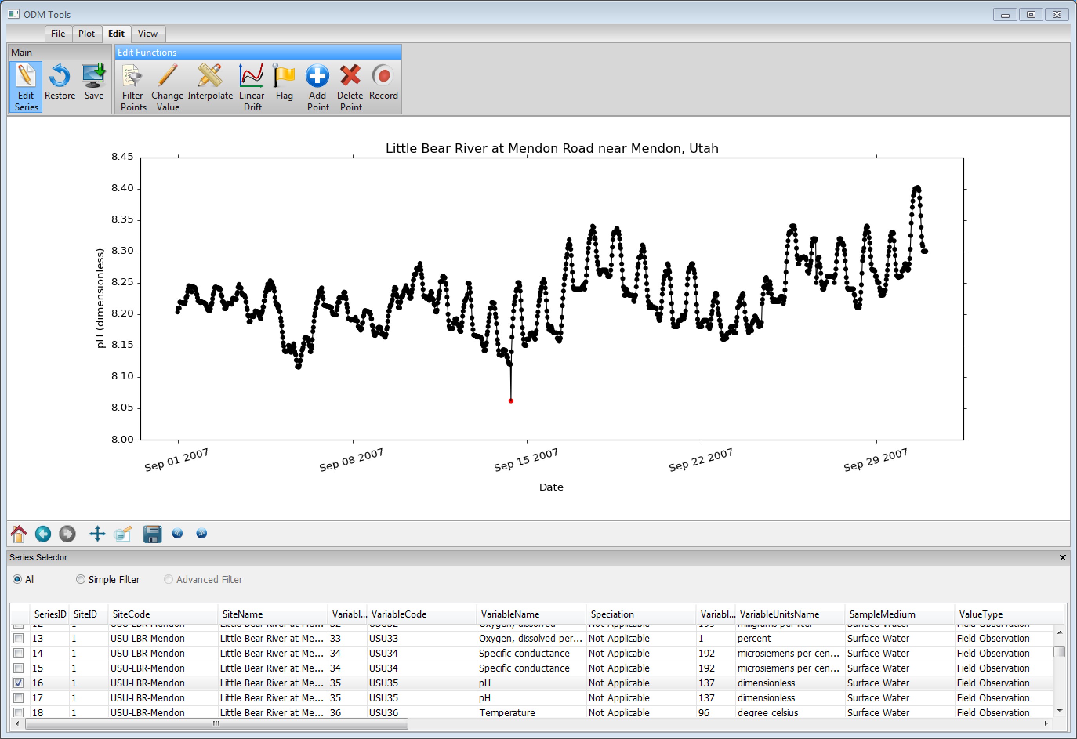
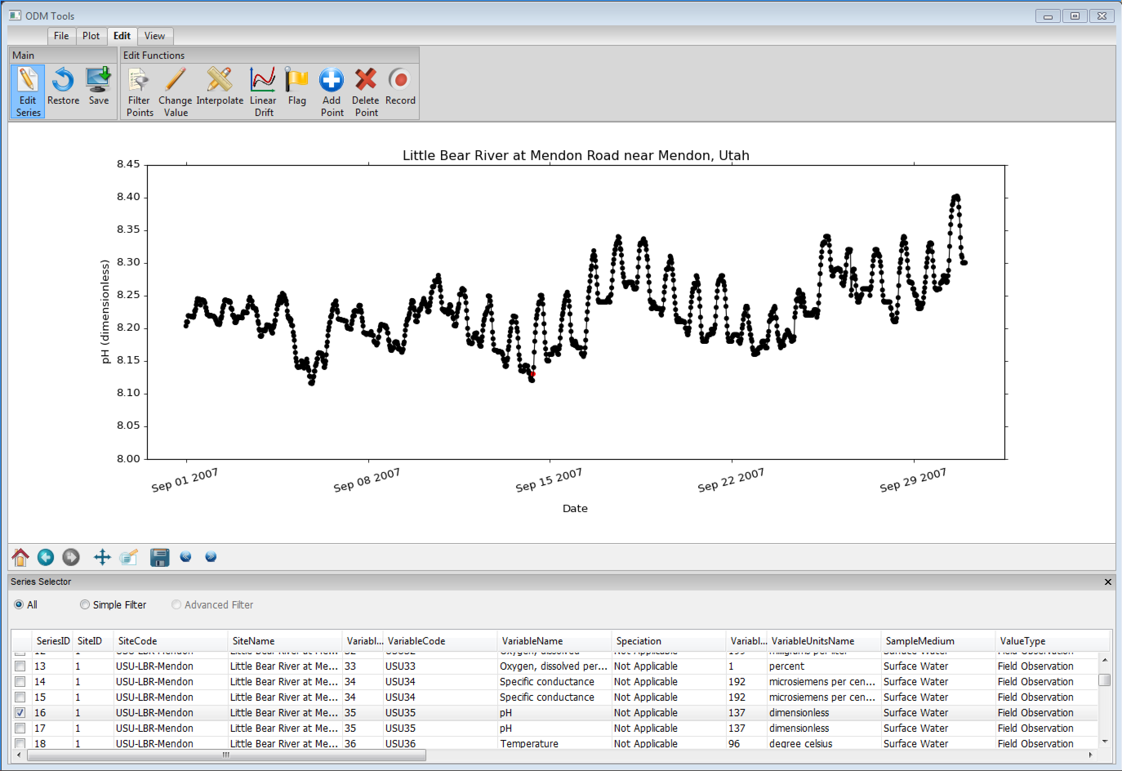
Step 4: Interpolate

Slide 21
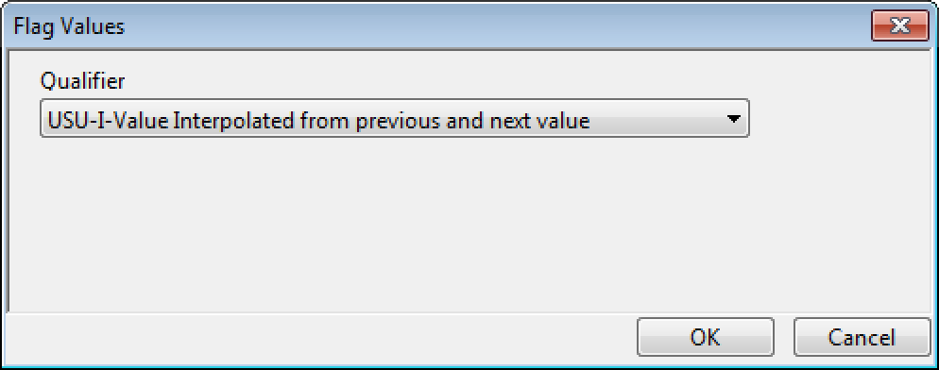
Step 5: Flag

Slide 22
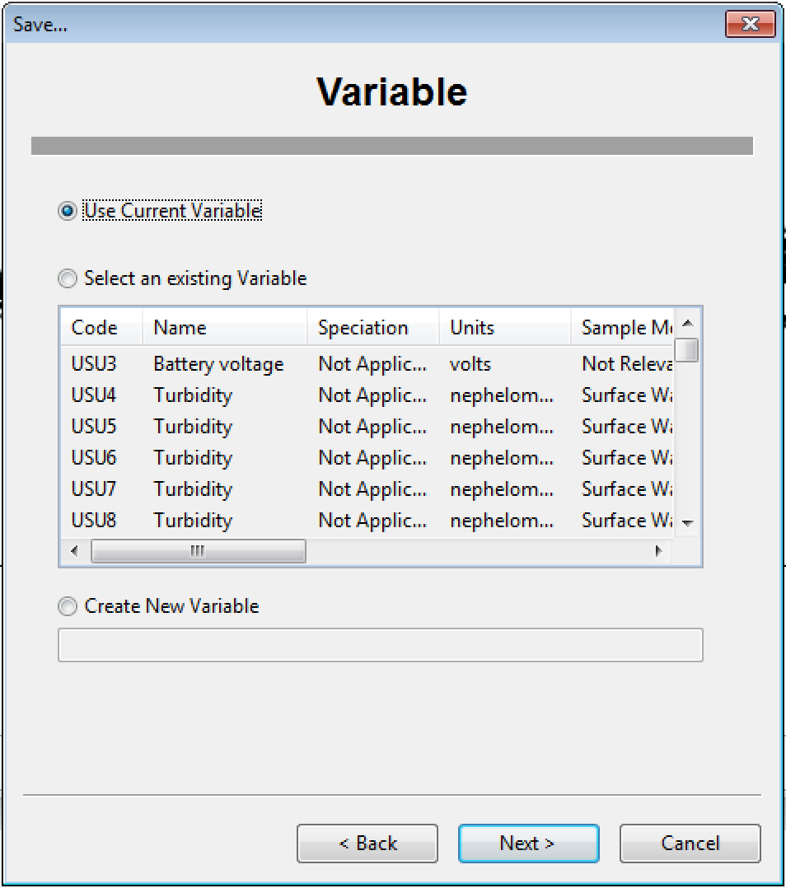
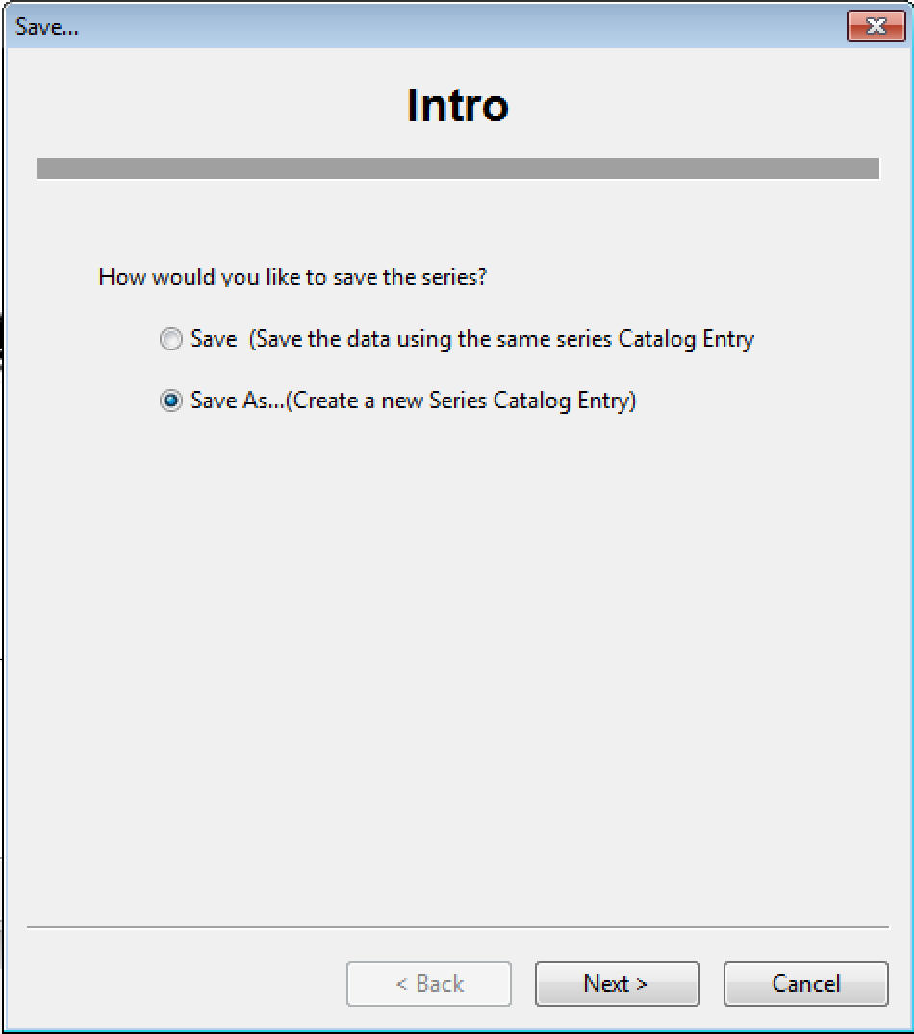
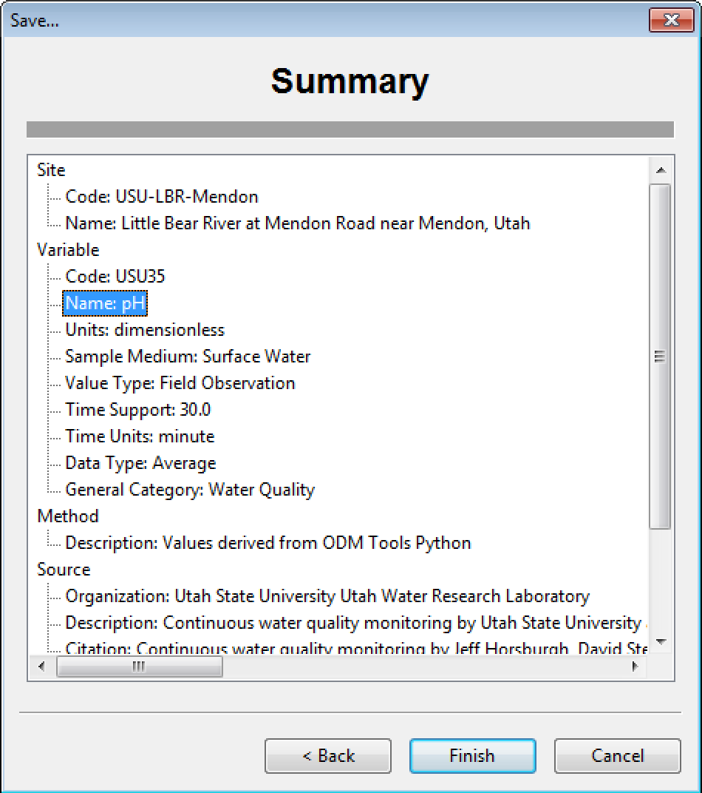
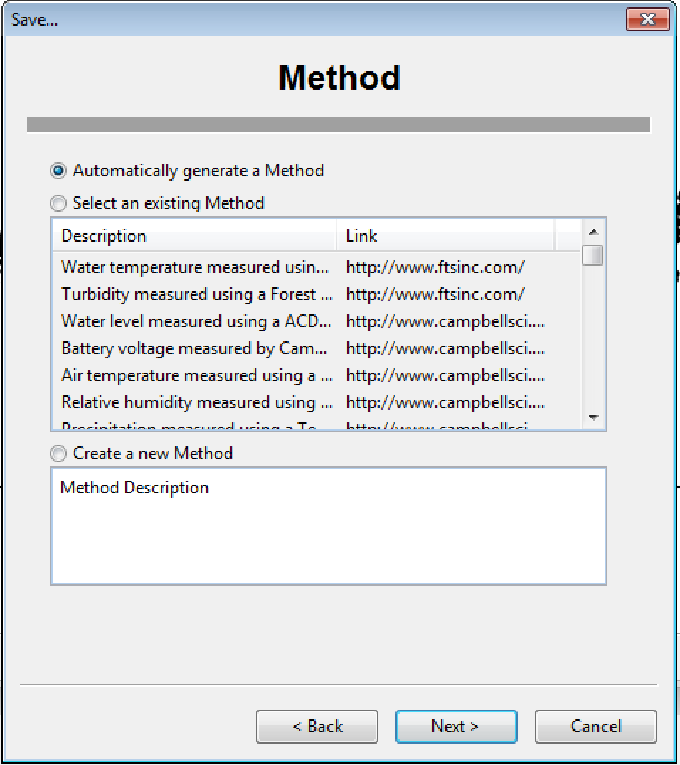
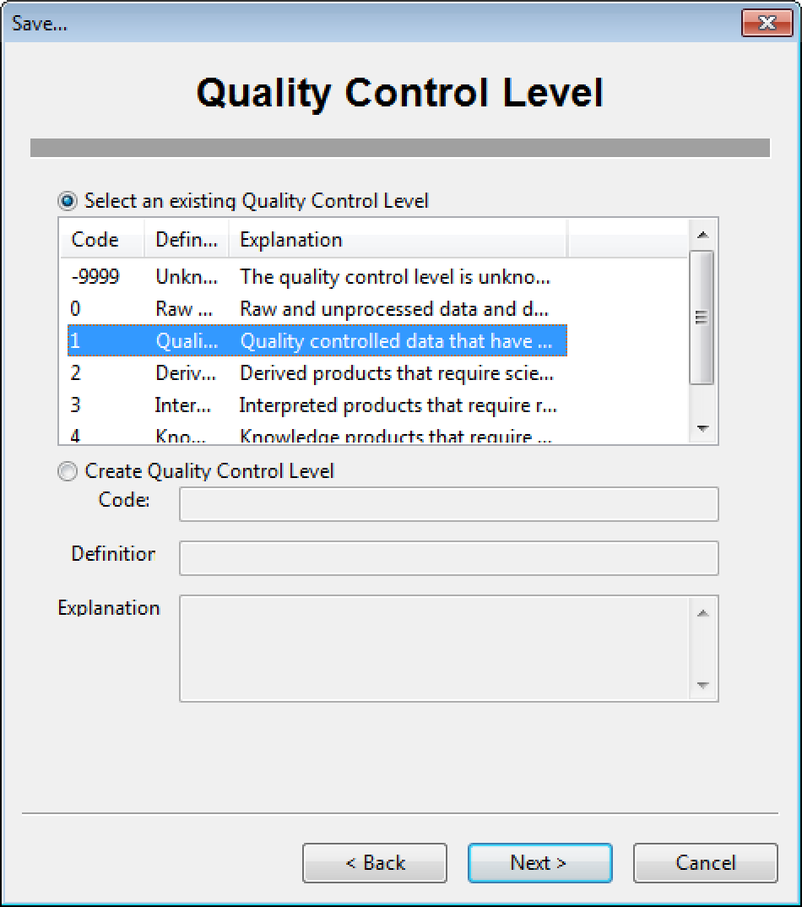
Step 6: Save Modified Data Series

Slide 23
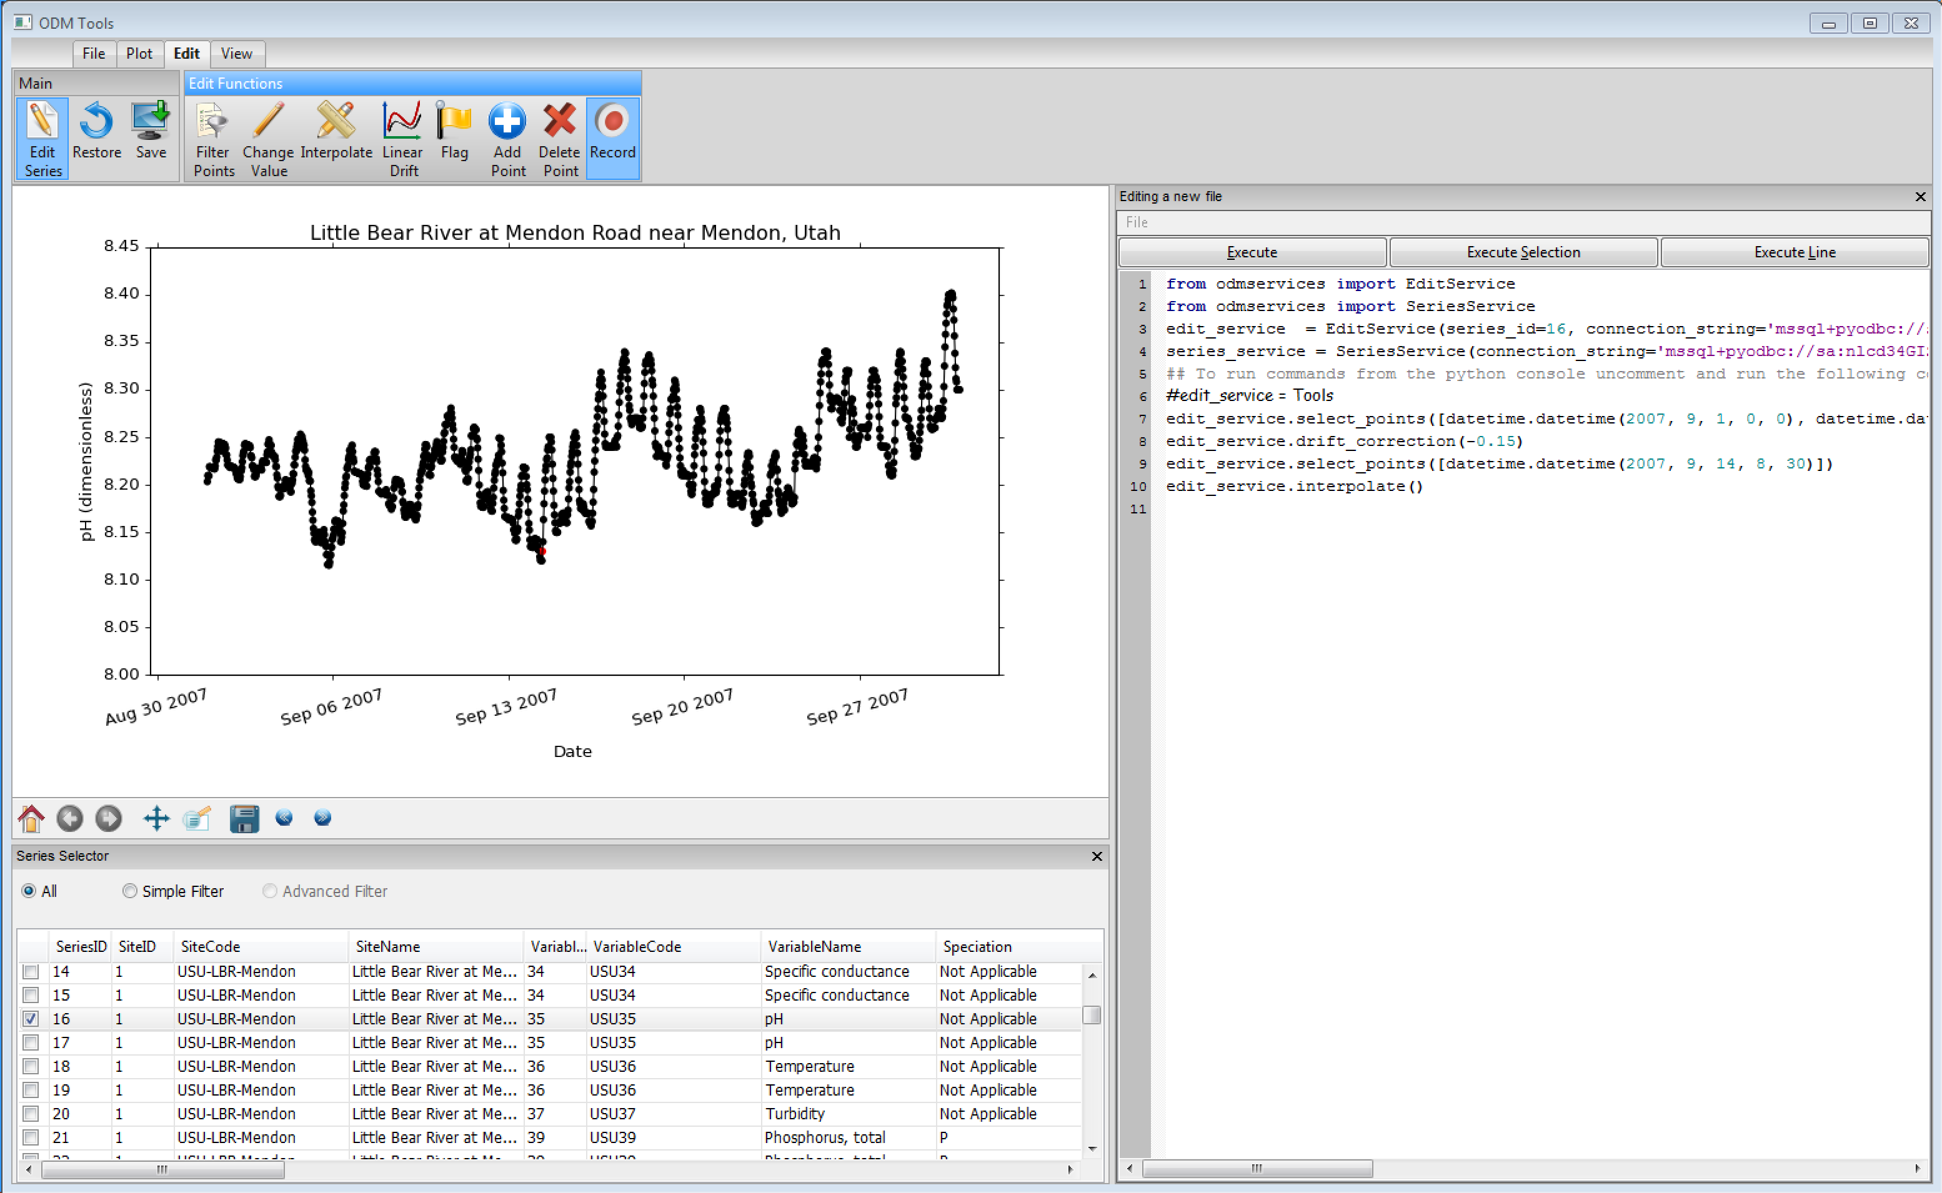
Recording Edits
Automatically generated Python code with each editing step

Slide 24
Ultimate Objective
Transform raw sensor data to quality controlled data in a repeatable way

Slide 25
Summary
ODM Tools Python is a cross platform (Windows, Mac) software for sensor data management
Visualization capabilities are helpful in screening new data as they arrive
ODM Tools provides GUI-based and scripting of data quality control edits

Slide 26


Questions?
This project is funded by National Science Foundation grant IIA-1208732.
Any opinions, findings, and conclusions or recommendations expressed in this material are those of the author(s) and do not necessarily reflect the views of the National Science Foundation.
OPEN SOURCE CODE REPOSITORY:
ODM Tools Python is available in GitHUB
https://github.com/UCHIC/ODMToolsPython

